Slide 1
Crowd Dynamics during evacuation
How does the density and distancing of people relate
to their velocity and outflux?
Daan Vinken, Daan Moll, Tian Gan, Bram Hoogland

Slide 2
Crowd Dynamics during evacuation
How does the density and distancing of people relate
to their velocity and outflux?
Daan Vinken, Daan Moll, Tian Gan, Bram Hoogland

Slide 3
Crowd Dynamics during evacuation
How does the density and distancing of people relate
to their velocity and outflux?
Daan Vinken, Daan Moll, Tian Gan, Bram Hoogland

Slide 4
Crowd Dynamics during evacuation
How does the density and distancing of people relate
to their velocity and outflux?
Daan Vinken, Daan Moll, Tian Gan, Bram Hoogland

Slide 5
Crowd Dynamics during evacuation
How does the density and distancing of people relate
to their velocity and outflux?
Daan Vinken, Daan Moll, Tian Gan, Bram Hoogland

Slide 6
Crowd Dynamics during evacuation
How does the density and distancing of people relate
to their velocity and outflux?
Daan Vinken, Daan Moll, Tian Gan, Bram Hoogland

Slide 7
Crowd Dynamics during evacuation
How does the density and distancing of people relate
to their velocity and outflux?
Daan Vinken, Daan Moll, Tian Gan, Bram Hoogland

Slide 8
Crowd Dynamics during evacuation
How does the density and distancing of people relate
to their velocity and outflux?
Daan Vinken, Daan Moll, Tian Gan, Bram Hoogland

Slide 9
Crowd Dynamics during evacuation
How does the density and distancing of people relate
to their velocity and outflux?
Daan Vinken, Daan Moll, Tian Gan, Bram Hoogland

Slide 10
Crowd Dynamics during evacuation
How does the density and distancing of people relate
to their velocity and outflux?
Daan Vinken, Daan Moll, Tian Gan, Bram Hoogland

Slide 11
Crowd Dynamics during evacuation
How does the density and distancing of people relate
to their velocity and outflux?
Daan Vinken, Daan Moll, Tian Gan, Bram Hoogland

Slide 12
Crowd Dynamics during evacuation
How does the density and distancing of people relate
to their velocity and outflux?
Daan Vinken, Daan Moll, Tian Gan, Bram Hoogland

Slide 13
Crowd Dynamics during evacuation
How does the density and distancing of people relate
to their velocity and outflux?
Daan Vinken, Daan Moll, Tian Gan, Bram Hoogland

Slide 14
Crowd Dynamics during evacuation
How does the density and distancing of people relate
to their velocity and outflux?
Daan Vinken, Daan Moll, Tian Gan, Bram Hoogland

Slide 15
Crowd Dynamics during evacuation
How does the density and distancing of people relate
to their velocity and outflux?
Daan Vinken, Daan Moll, Tian Gan, Bram Hoogland

Slide 16
Crowd Dynamics during evacuation
How does the density and distancing of people relate
to their velocity and outflux?
Daan Vinken, Daan Moll, Tian Gan, Bram Hoogland

Slide 17
Crowd Dynamics during evacuation
How does the density and distancing of people relate
to their velocity and outflux?
Daan Vinken, Daan Moll, Tian Gan, Bram Hoogland

Slide 18
Crowd Dynamics during evacuation
How does the density and distancing of people relate
to their velocity and outflux?
Daan Vinken, Daan Moll, Tian Gan, Bram Hoogland

Slide 19
Crowd Dynamics during evacuation
How does the density and distancing of people relate
to their velocity and outflux?
Daan Vinken, Daan Moll, Tian Gan, Bram Hoogland

Slide 20
Crowd Dynamics during evacuation
How does the density and distancing of people relate
to their velocity and outflux?
Daan Vinken, Daan Moll, Tian Gan, Bram Hoogland

Slide 21
Crowd Dynamics during evacuation
How does the density and distancing of people relate
to their velocity and outflux?
Daan Vinken, Daan Moll, Tian Gan, Bram Hoogland

Slide 22
Crowd Dynamics during evacuation
How does the density and distancing of people relate
to their velocity and outflux?
Daan Vinken, Daan Moll, Tian Gan, Bram Hoogland

Slide 23
Crowd Dynamics during evacuation
How does the density and distancing of people relate
to their velocity and outflux?
Daan Vinken, Daan Moll, Tian Gan, Bram Hoogland

Slide 24
Crowd Dynamics during evacuation
How does the density and distancing of people relate
to their velocity and outflux?
Daan Vinken, Daan Moll, Tian Gan, Bram Hoogland

Slide 25
Crowd Dynamics during evacuation
How does the density and distancing of people relate
to their velocity and outflux?
Daan Vinken, Daan Moll, Tian Gan, Bram Hoogland

Slide 26
Crowd Dynamics during evacuation
How does the density and distancing of people relate
to their velocity and outflux?
Daan Vinken, Daan Moll, Tian Gan, Bram Hoogland

Slide 27
Crowd Dynamics during evacuation
How does the density and distancing of people relate
to their velocity and outflux?
Daan Vinken, Daan Moll, Tian Gan, Bram Hoogland

Slide 28
Crowd Dynamics during evacuation
How does the density and distancing of people relate
to their velocity and outflux?
Daan Vinken, Daan Moll, Tian Gan, Bram Hoogland

Slide 29

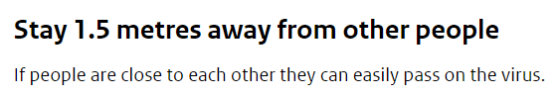
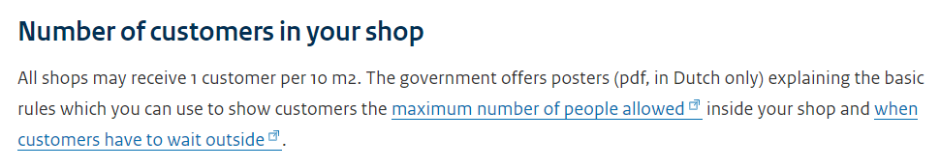
Motivation
How can congestion in small entrances be prevented?
Not exactly “new” research….
Distance between people
Density in rooms

Slide 30
Research Question
How does the density and distancing of people relate
to their velocity and outflux?

Slide 31
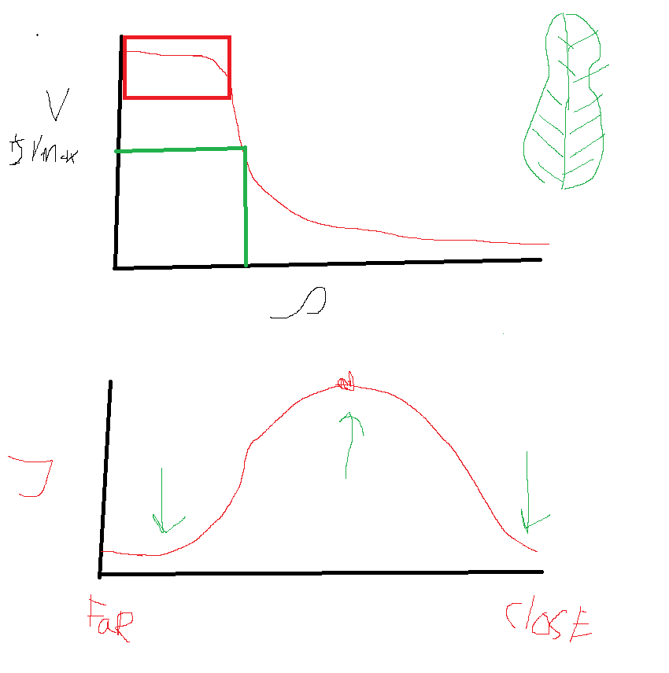

Hypothesis
How does the density and distancing of people relate
to their velocity and outflux?

Slide 32
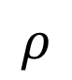
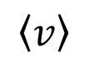

Hypothesis
How does the density and distancing of people relate
to their velocity and outflux?
$$\left\langle v\right\rangle$$
Outflux
$$ρ$$
Desired Distance
Large
Small

Slide 33

Model: Environment

Slide 34
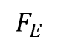
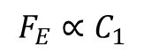
Model: Dynamics
Attractive Exit Force
Repulsive Force
Friction Force
$$F_{E}$$
WALL
$$F_{E}∝C_{1}$$

Slide 35
Model: Dynamics
Attractive Exit Force
Repulsive Force
Friction Force
Interaction Range
$$F_{E}$$
WALL
$$F_{E}∝C_{1}$$

Slide 36
Model: Dynamics
Attractive Exit Force
Repulsive Force
Friction Force
Interaction Range
$$F_{E}$$
WALL
$$F_{E}∝C_{1}$$

Slide 37
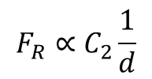
Model: Dynamics
Attractive Exit Force
Repulsive Force
Friction Force
Interaction Range
$$F_{E}$$
d
WALL
d
$$F_{R}∝C_{2}\frac{1}{d}$$
$$F_{E}∝C_{1}$$

Slide 38
Model: Dynamics
Attractive Exit Force
Repulsive Force
Friction Force
Interaction Range
$$F_{E}$$
d
WALL
d
$$F_{R}∝C_{2}\frac{1}{d}$$
$$F_{E}∝C_{1}$$

Slide 39
Model: Dynamics
Attractive Exit Force
Repulsive Force
Friction Force
Interaction Range
$$F_{E}$$
d
WALL
d
$$F_{R}∝C_{2}\frac{1}{d}$$
$$F_{E}∝C_{1}$$

Slide 40
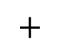
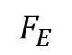
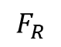
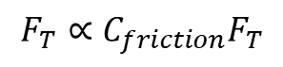
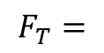
Model: Dynamics
Attractive Exit Force
Repulsive Force
Friction Force
Interaction Range
$$F_{T}=$$
$$F_{E}$$
$$+$$
$$F_{R}$$
$$F_{E}$$
d
WALL
d
$$F_{R}∝C_{2}\frac{1}{d}$$
$$F_{T}∝{C_{friction}F}_{T}$$
$$F_{E}∝C_{1}$$

Slide 41
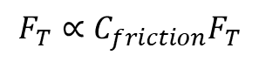
Model: Dynamics
Attractive Exit Force
Repulsive Force
Friction Force
Interaction Range
$$F_{T}=$$
$$F_{E}$$
$$+$$
$$F_{R}$$
$$F_{E}$$
d
WALL
d
$$F_{R}∝C_{2}\frac{1}{d}$$
$$F_{T}∝{C_{friction}F}_{T}$$
$$F_{E}∝C_{1}$$

Slide 42
Parameters and descriptions
R | Radius of agent | 1.5
DENSITY | Total density of the agents | 0.1
CLOSE_DISTANCE | Distance between agents where repulsive forces arise | 5R
TOUCH_DISTANCE | Distance between agents where friction forces arise | 2R
COMPLETE_STOP | Minimum distance to other agents | R
GATE_ATTR_FORCE | Attraction force to exit for agents | 10
HUMAN_REPULS_FORCE | Repulsion force between agents | 4
WALL_REPULS_FORCE | Repulsion force by walls on agents | 5
MAX_FRICTION | Maximal friction between agents | 0.3

Slide 43
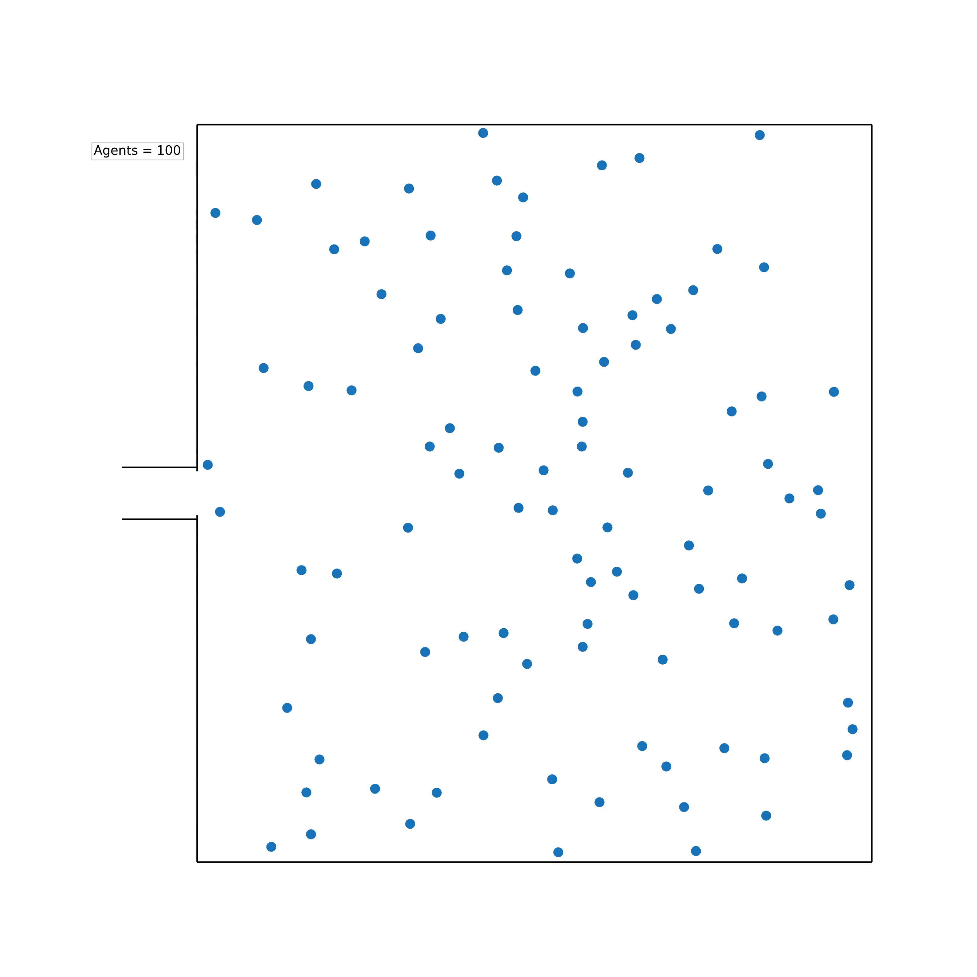
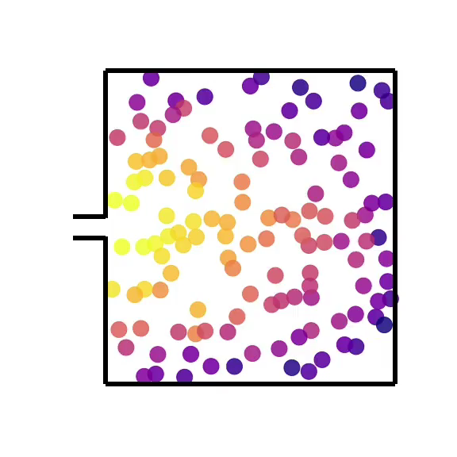
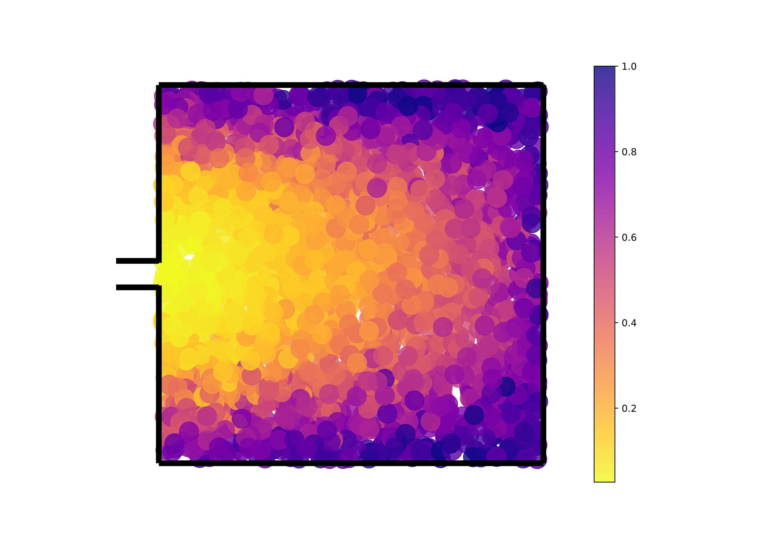
Example run

Slide 44
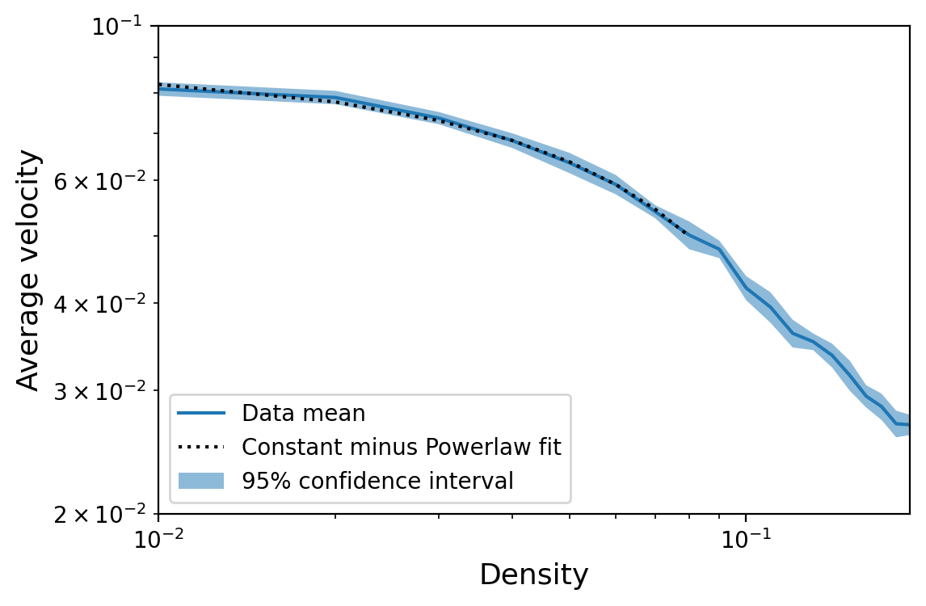
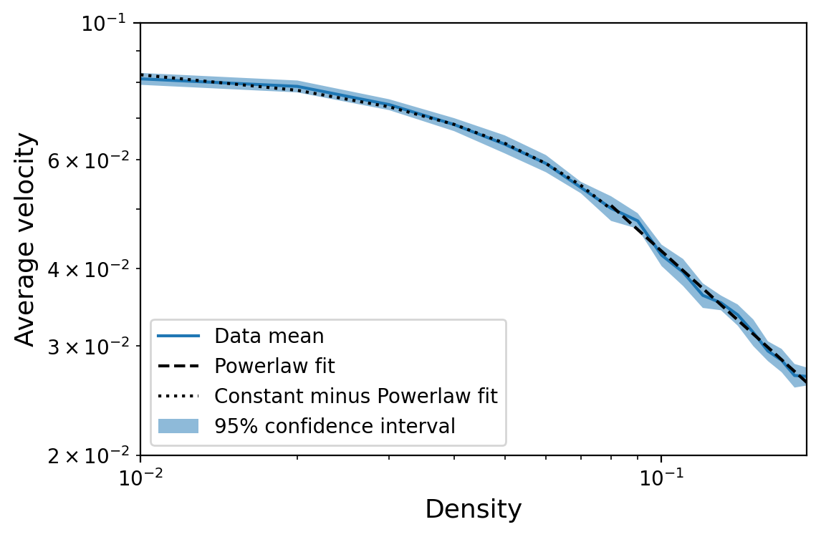
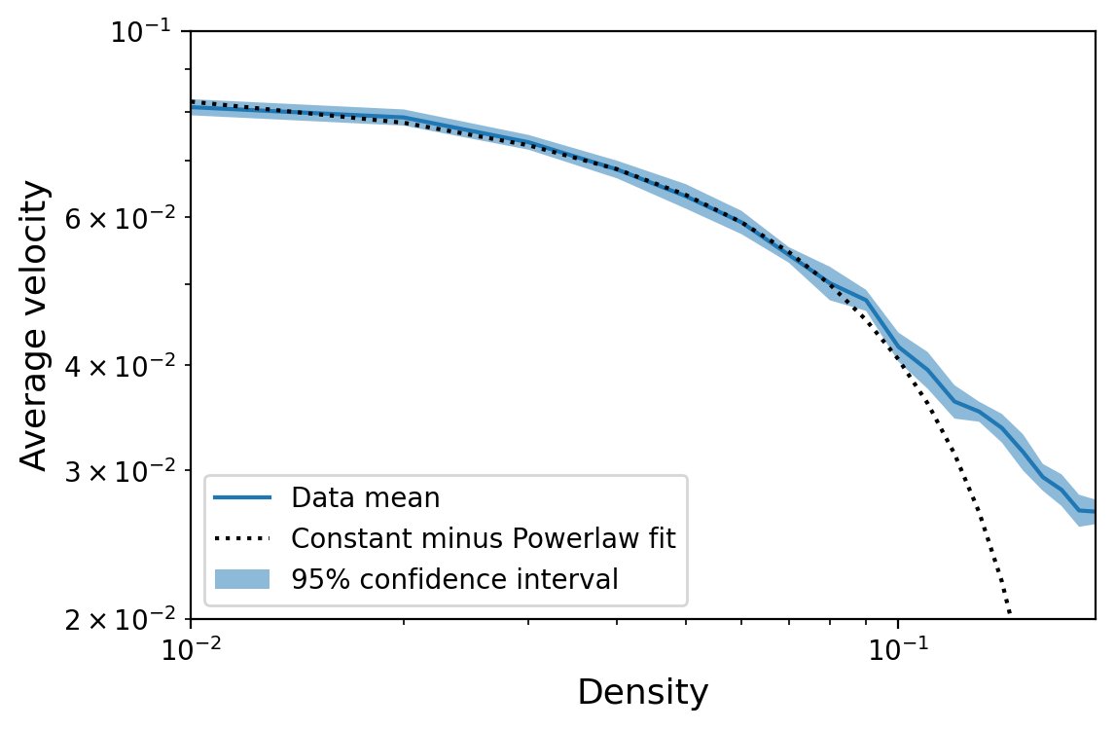
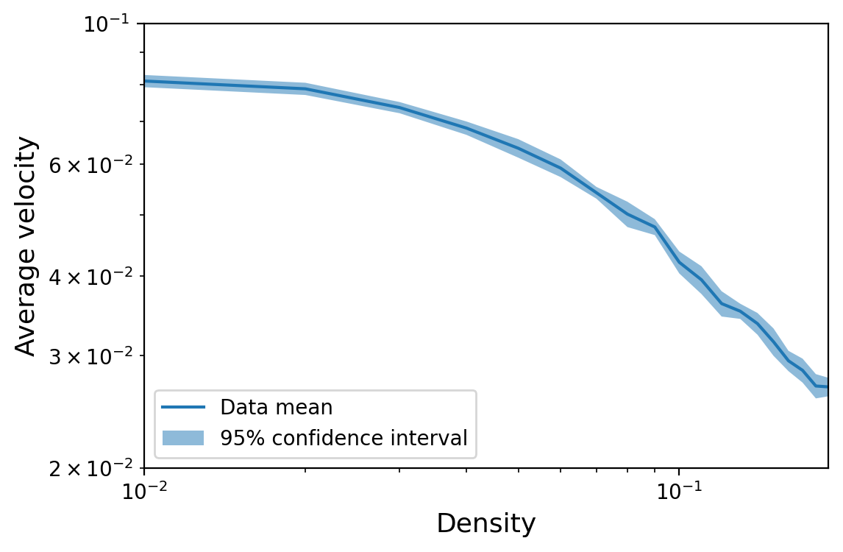
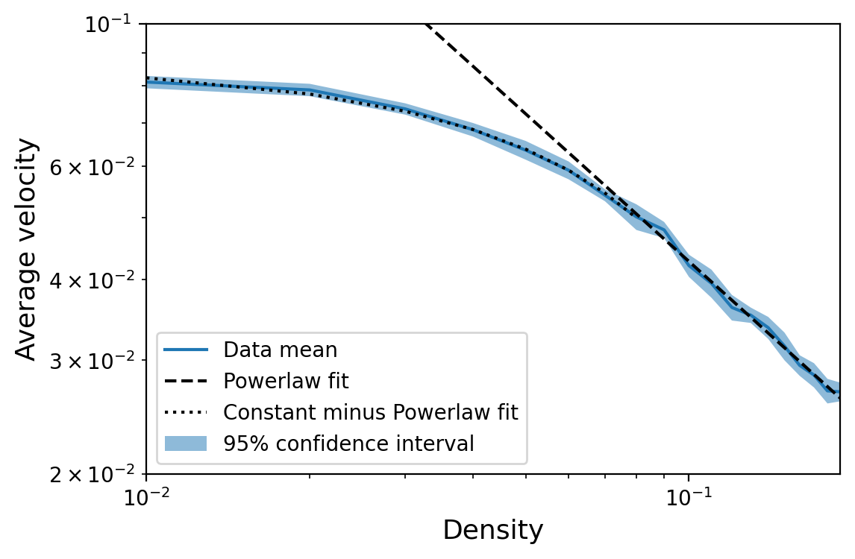
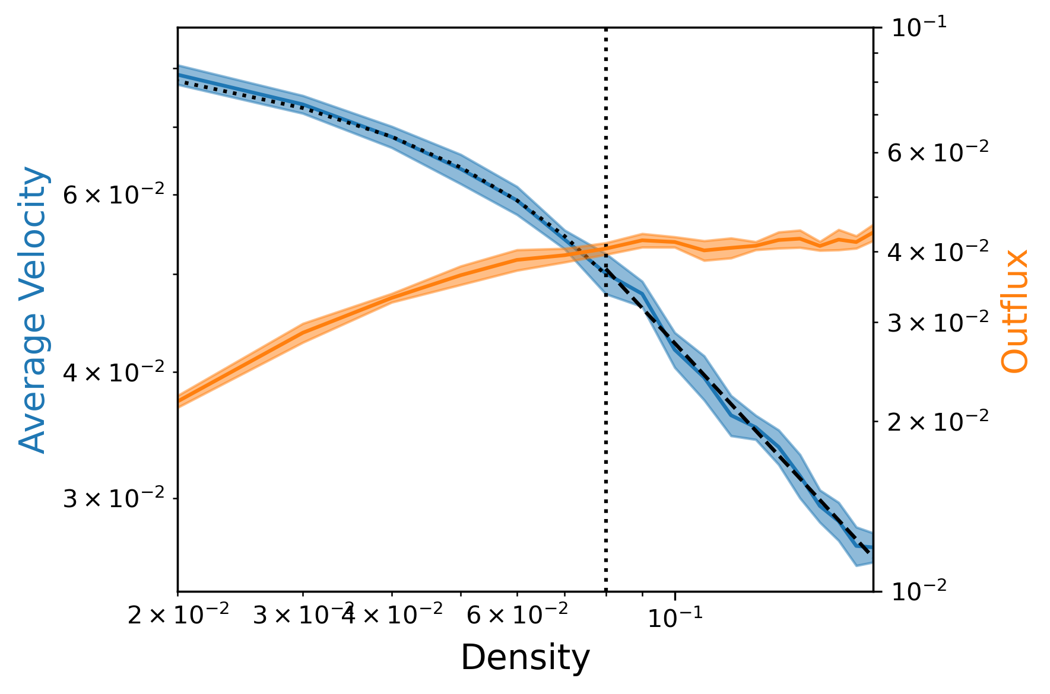
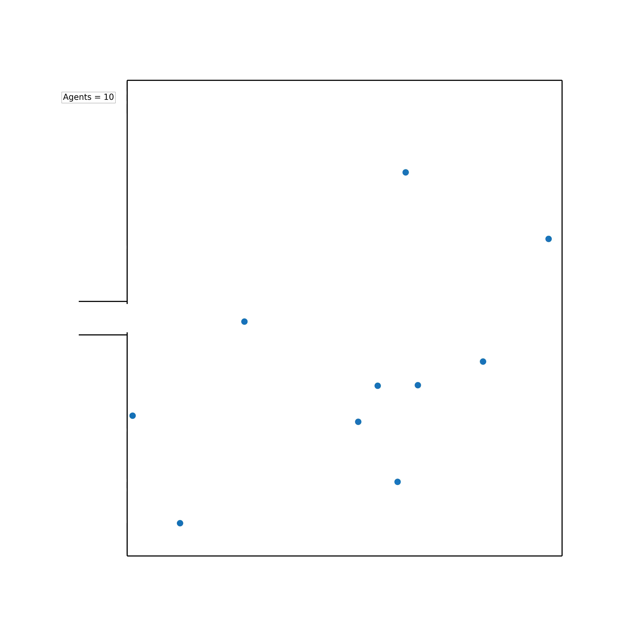
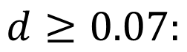
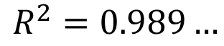
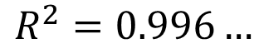
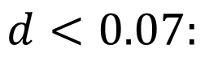
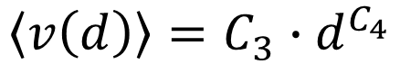
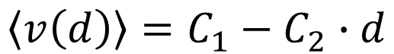
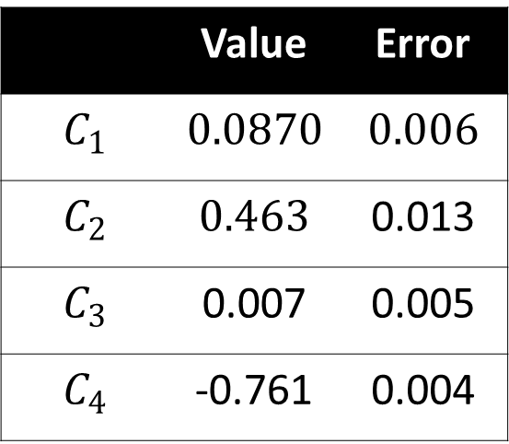
Results: Density
$$d<0.07:$$
$$\left\langle v\left(d\right)\right\rangle =C_{1}−C_{2}∙d$$
$$d≥0.07:$$
$$\left\langle v\left(d\right)\right\rangle =C_{3}∙d^{C_{4}}$$
$$R^{2}=0.996…$$
 | Value | Error
$$C_{1}$$ | $$0.0870$$ | $$0.006$$
$$C_{2}$$ | $$0.463$$ | 0.013
$$C_{3}$$ | 0.007 | 0.005
$$C_{4}$$ | -0.761 | 0.004
$$R^{2}=0.989…$$

Slide 45
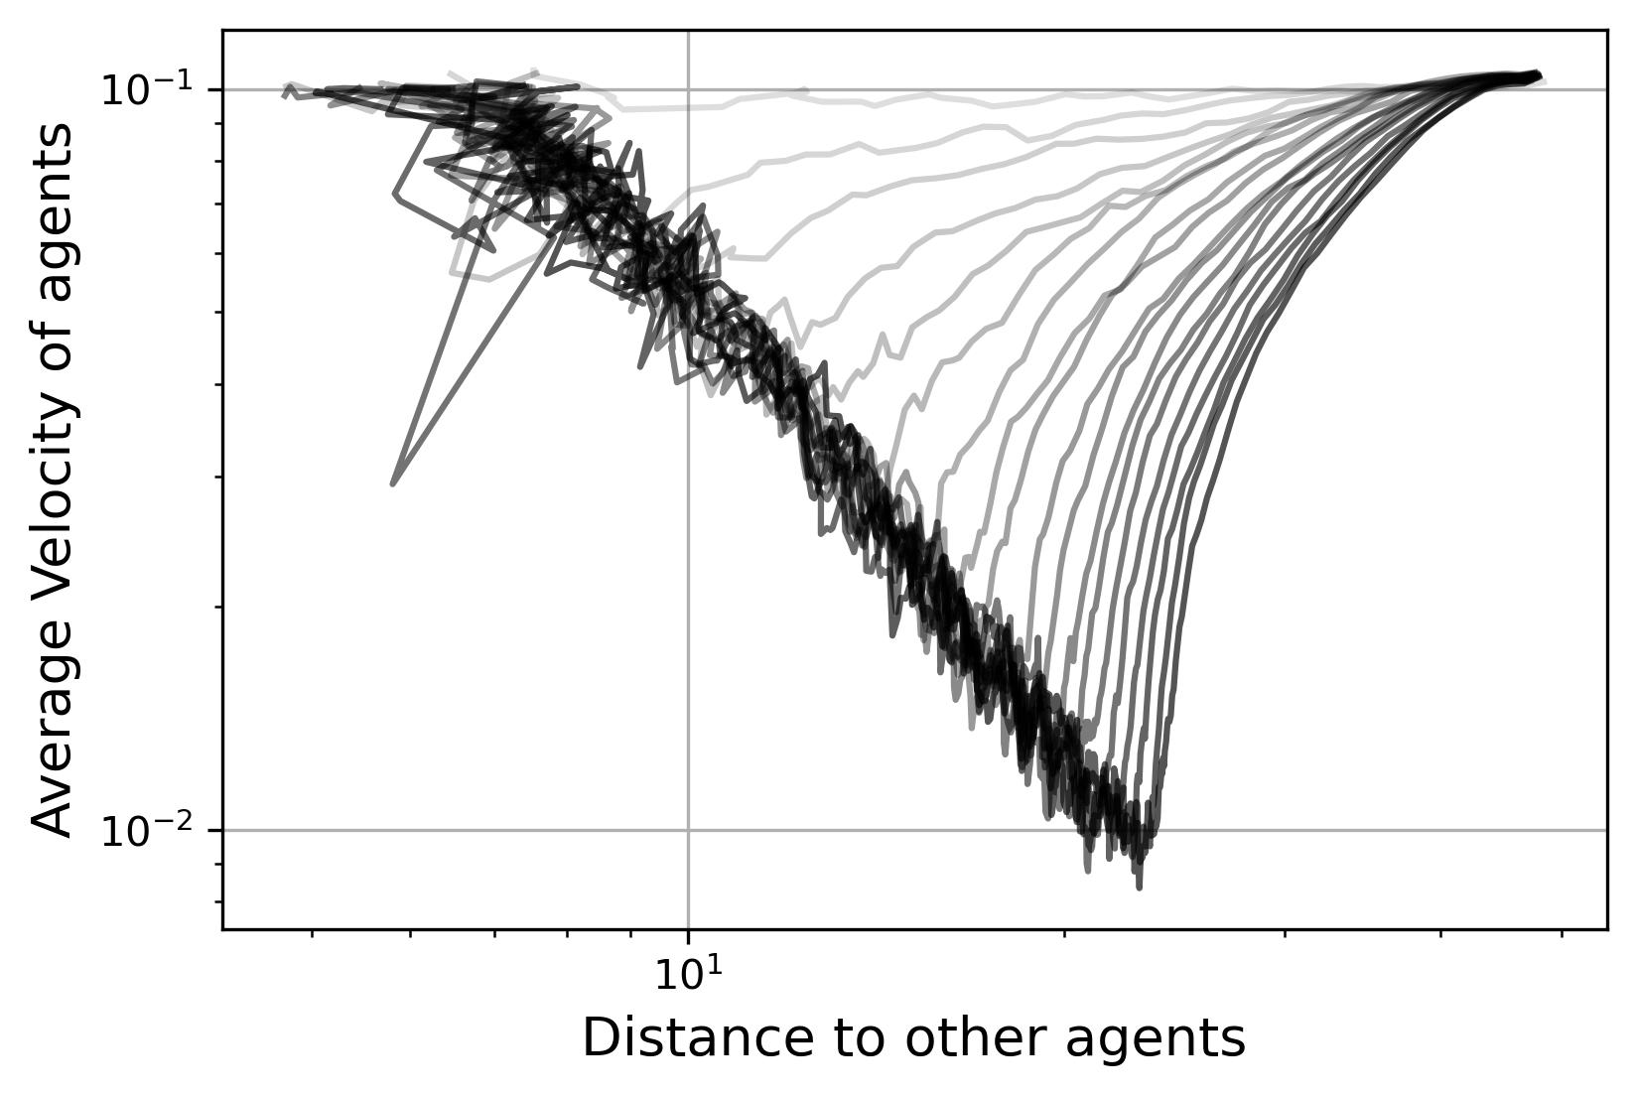
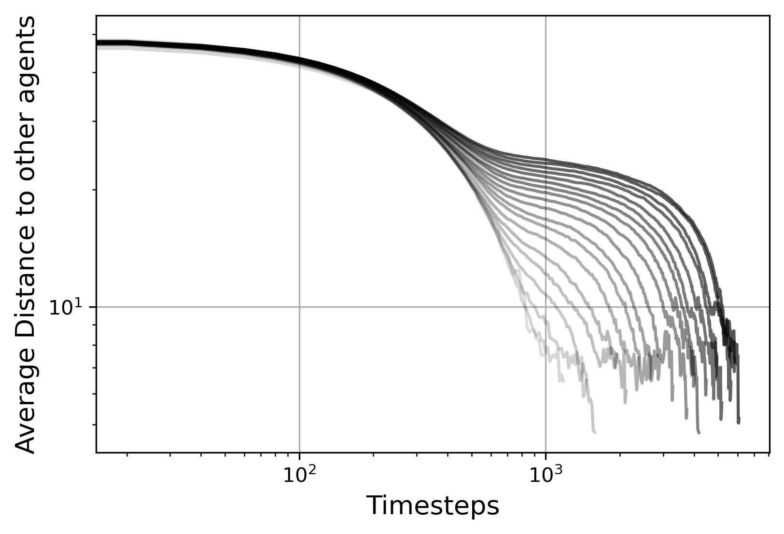
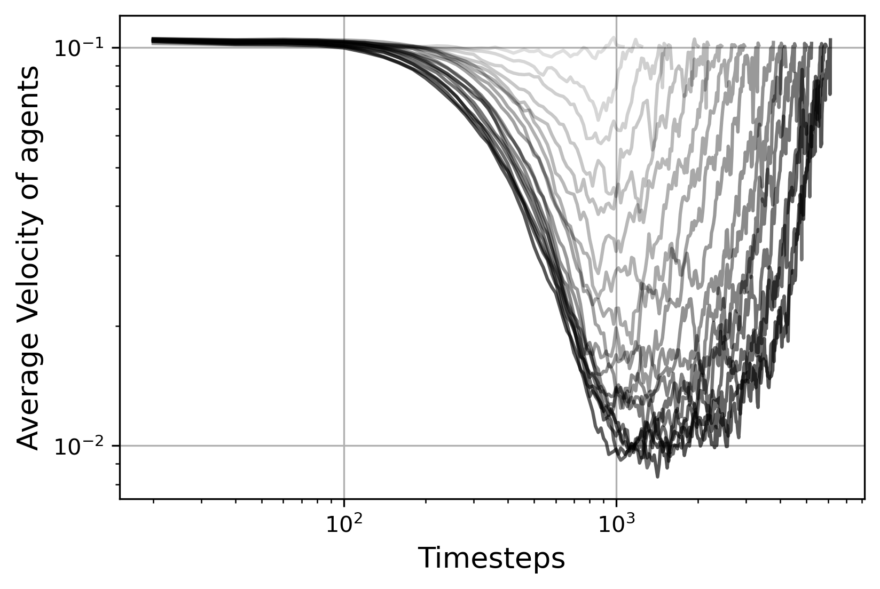
Results: Density

Slide 46
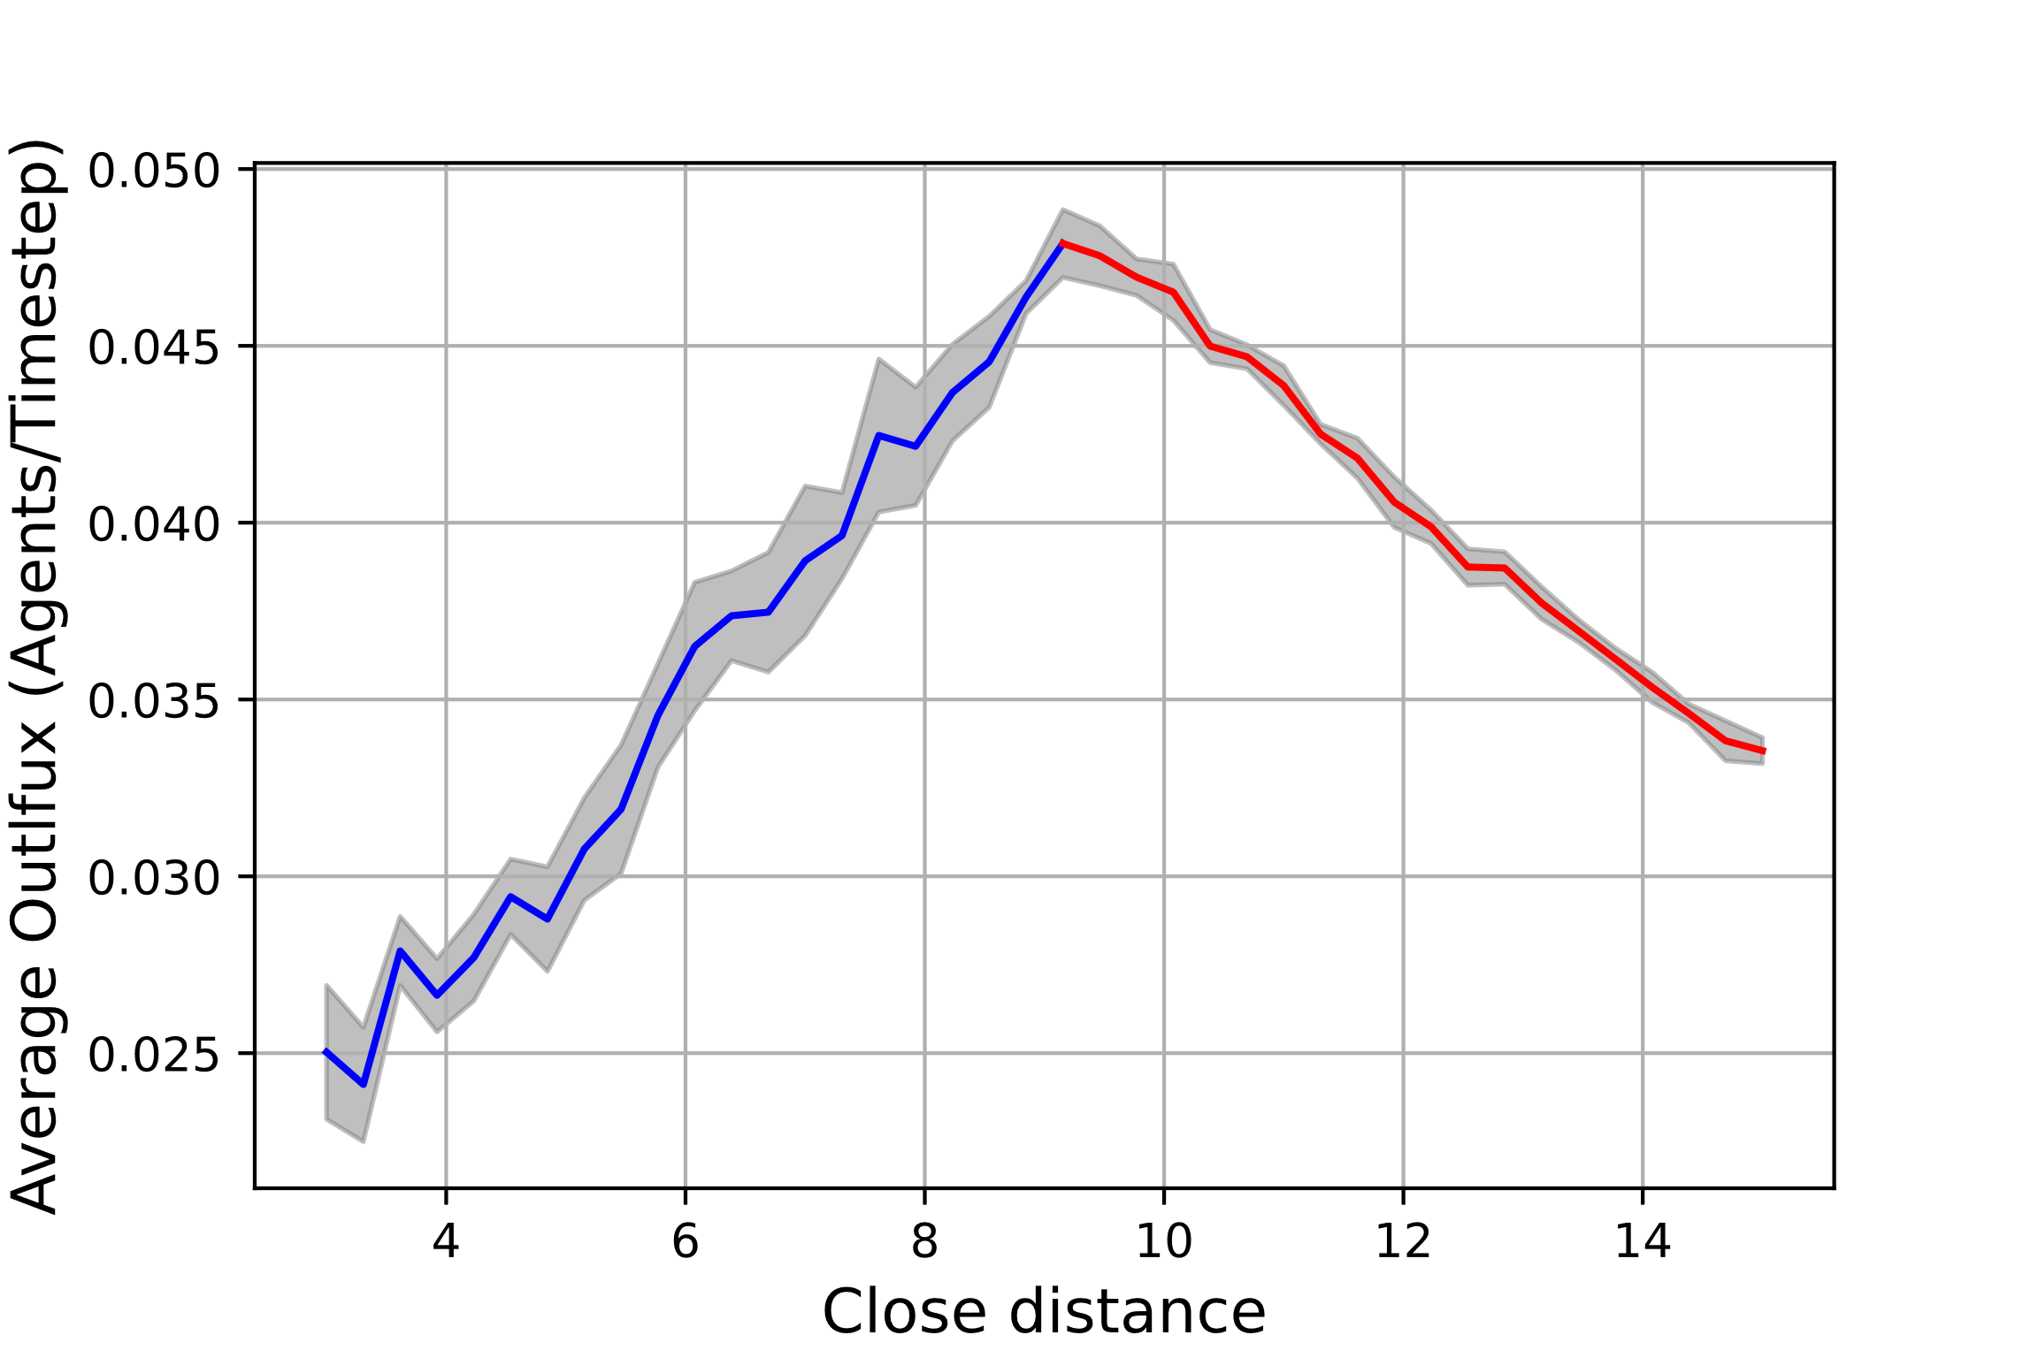
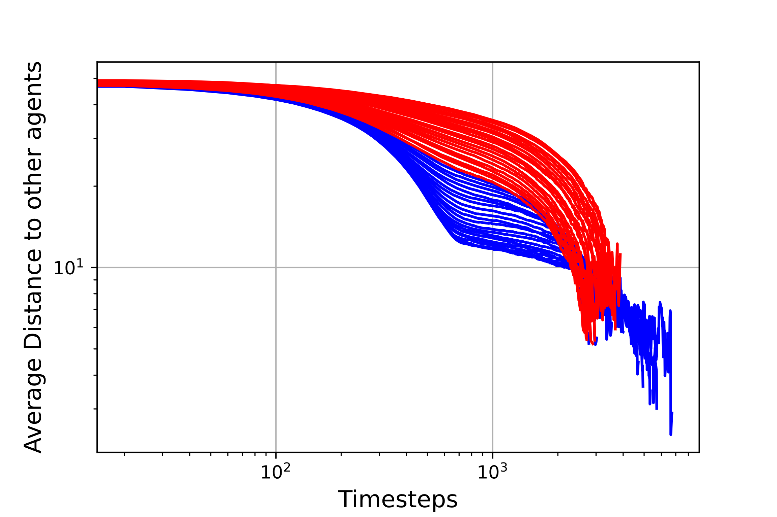
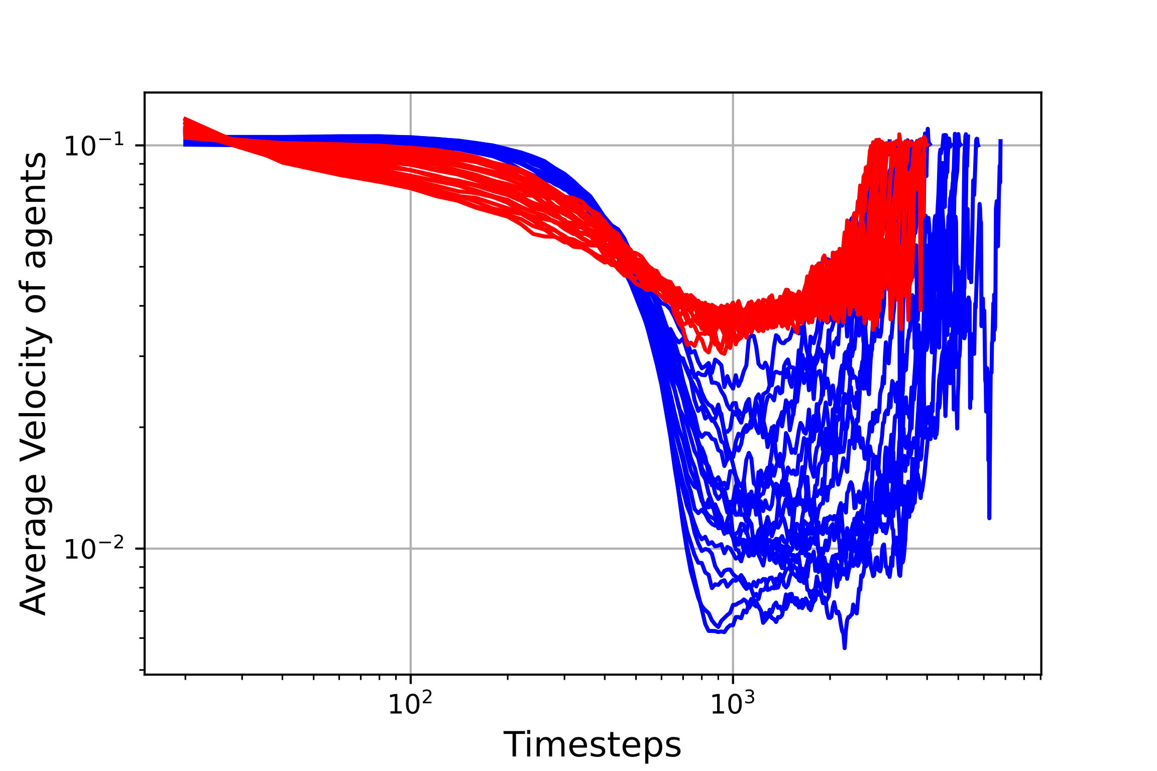
Results: Repulsive Force
Interaction Range

Slide 47
Discussion
Model not perfect
People form straight lines
Adding diffusive term might solve this
Environment was simple and constant
Allowed for close study of interactions
Conclusion might not be general applicable
The model deterministic
If only groups of people were…

Slide 48
Conclusion
How does the density and distancing of people relate
to their velocity and outflux?

Slide 49
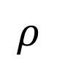
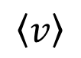
Conclusion
How does the density and distancing of people relate
to their velocity and outflux?
$$\left\langle v\right\rangle$$
$$ρ$$

Slide 50

Conclusion
How does the density and distancing of people relate
to their velocity and outflux?
Outflux
Desired Distance
Small
Large

Slide 51
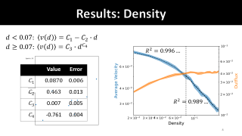
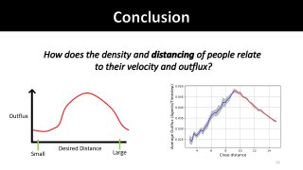
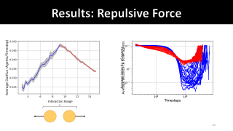
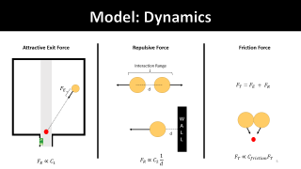
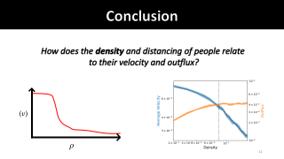
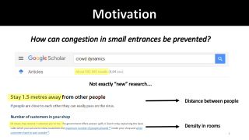
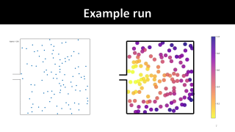
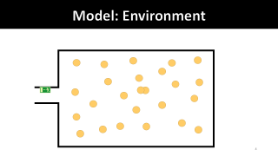
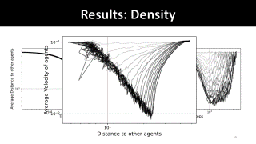
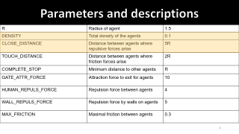
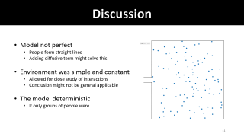

Questions

